Slide 1

8th Grade Math: Pre-Algebra
Unit 12, Lesson 2 Multiplying Monomials by Algebraic Expressions Volume 2, pg. 222

Slide 2


Benchmarks
MA.8.AR.1.1
Apply the Laws of Exponents to generate equivalent algebraic expressions, limited to integer exponents and monomial bases.
MA.8.AR.1.2
Apply properties of operations to multiply two linear expressions with rational coefficients.
volume 2, pg. 222

Slide 3
Integrated Mathematical Thinking and Reasoning Standards
MA.K12.MTR.2.1 Demonstrate understanding by representing problems in multiple ways.
MA.K12.MTR.3.1 Complete tasks with mathematical fluency.
MA.K12.MTR.4.1 Engage in discussions that reflect on the mathematical thinking of self and others.
volume 2, pg. 222

Slide 4

Learning Targets
I can apply properties of operations to multiply two linear expressions.
I can multiply a monomial by an algebraic expression.
volume 2, pg. 222

Slide 5

Warm-Up
volume 2, pg. 222

Slide 6
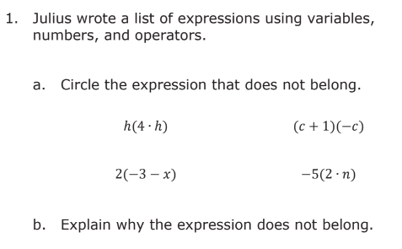
12.2.1 Warm-Up: Which One Doesn’t Belong?
volume 2, pg. 222

Slide 7

Collaboration
volume 2, pg. 223

Slide 8

12.2.2 Collaboration: Applying Properties of Operations to Multiply Linear Expressions
With your partner, determine who is Partner A and who is Partner B.
Apply the distributive property to re-write each expression in your column in the space provided below each given expression.
volume 2, pg. 223

Slide 9
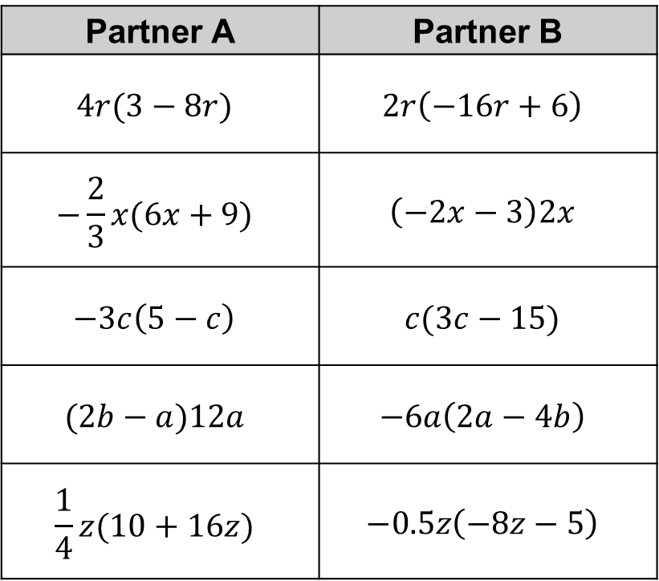
Partner A | Partner B
$$4r(3−8r)$$ | $$2r\left(−16r+6\right)$$
$$−\frac{2}{3}x(6x+9)$$ | $$\left(−2x−3\right)2x$$
$$−3c\left(5−c\right)$$ | $$c(3c−15)$$
$$(2b−a)12a$$ | $$−6a\left(2a−4b\right)$$
$$\frac{1}{4}z(10+16z)$$ | $$−0.5z\left(−8z−5\right)$$
Compare your work with your partner. The expressions in each row are equivalent. If your expressions are not equivalent, work together to find and correct any error(s).
volume 2, pg. 223

Slide 10
Collaboration
volume 2, pg. 223

Slide 11
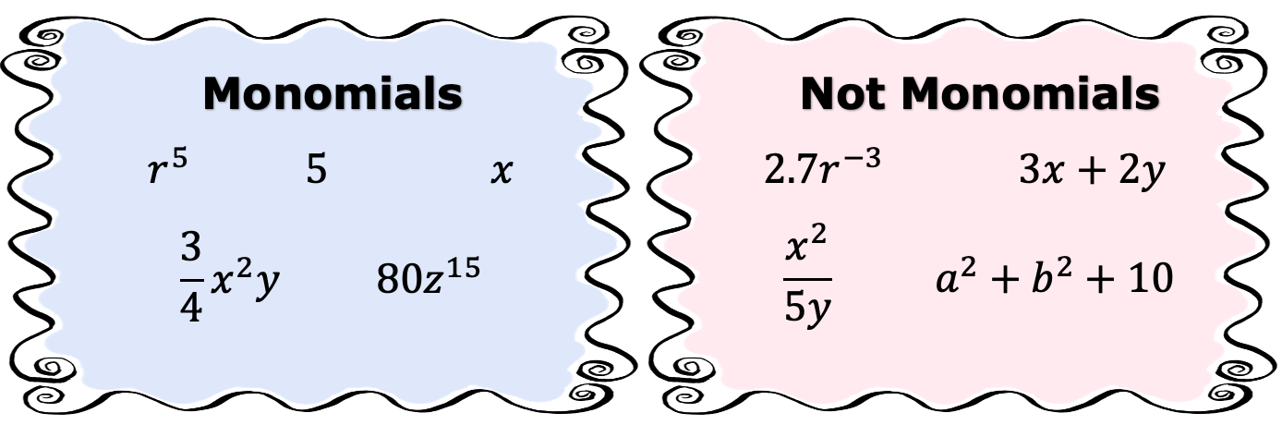
12.2.3 Collaboration: Defining Monomials
The charts below show several examples and non-examples of monomials.
volume 2, pg. 223

Slide 12
Create a list of identifying features monomials can have versus features they cannot have.
Compare your lists with your partner. Add any additional features you found after your discussion.
Work with your partner to write a definition of a monomial.
Monomials Can Have ... | Monomials Cannot Have …
volume 2, pg. 223

Slide 13
Ask two other pairs of partners about the definition they wrote. Listen to their definition and write a summary. You are the only person who should write in the first column of the table. Have the person initial next to your summary stating that your summary was accurate.
Review the definitions with your partner and make any necessary adjustments to your own definition.
My Summary of the Definition of a Monomial | Initials
volume 2, pg. 224

Slide 14
Work with your partner to complete the statement. Select all that apply.
A monomial is a with exponents.
single number
single variable
sum of numbers and variables
product of numbers and variables
whole number
integer
rational
volume 2, pg. 224

Slide 15

Guided Instruction
volume 2, pg. 224

Slide 16
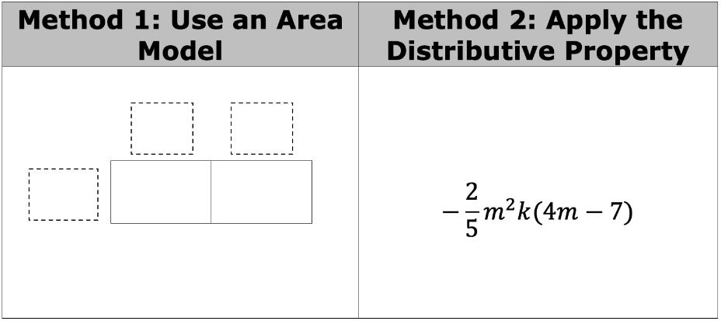
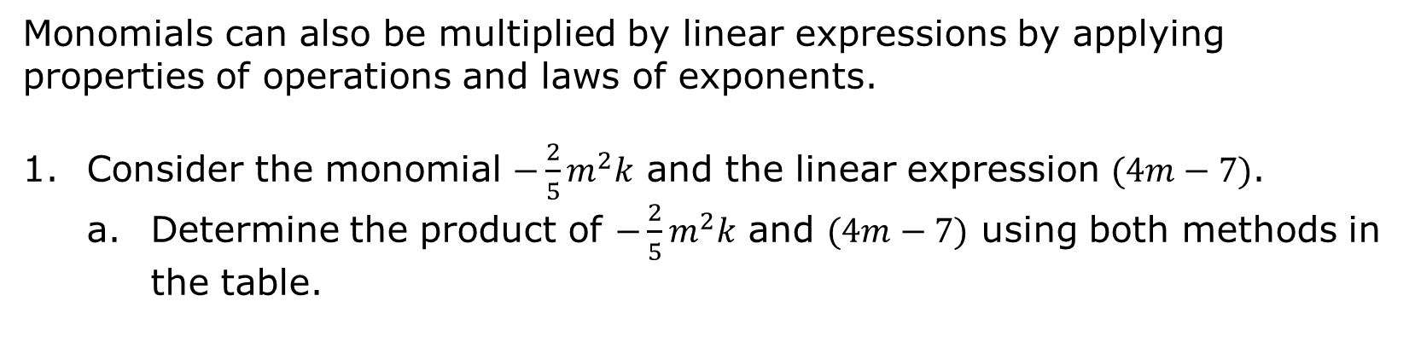
12.2.4 Guided Instruction: Multiplying a Monomial by a Linear Expression
Monomials can also be multiplied by linear expressions by applying properties of operations and laws of exponents.
Consider the monomial $−\frac{2}{5}m^{2}k$ and the linear expression $(4m−7)$.
Determine the product of $−\frac{2}{5}m^{2}k$ and $(4m−7)$ using both methods in the table.
Write another expression equivalent to the product.
volume 2, pg. 224

Slide 17

Guided Practice
volume 2, pg. 225

Slide 18

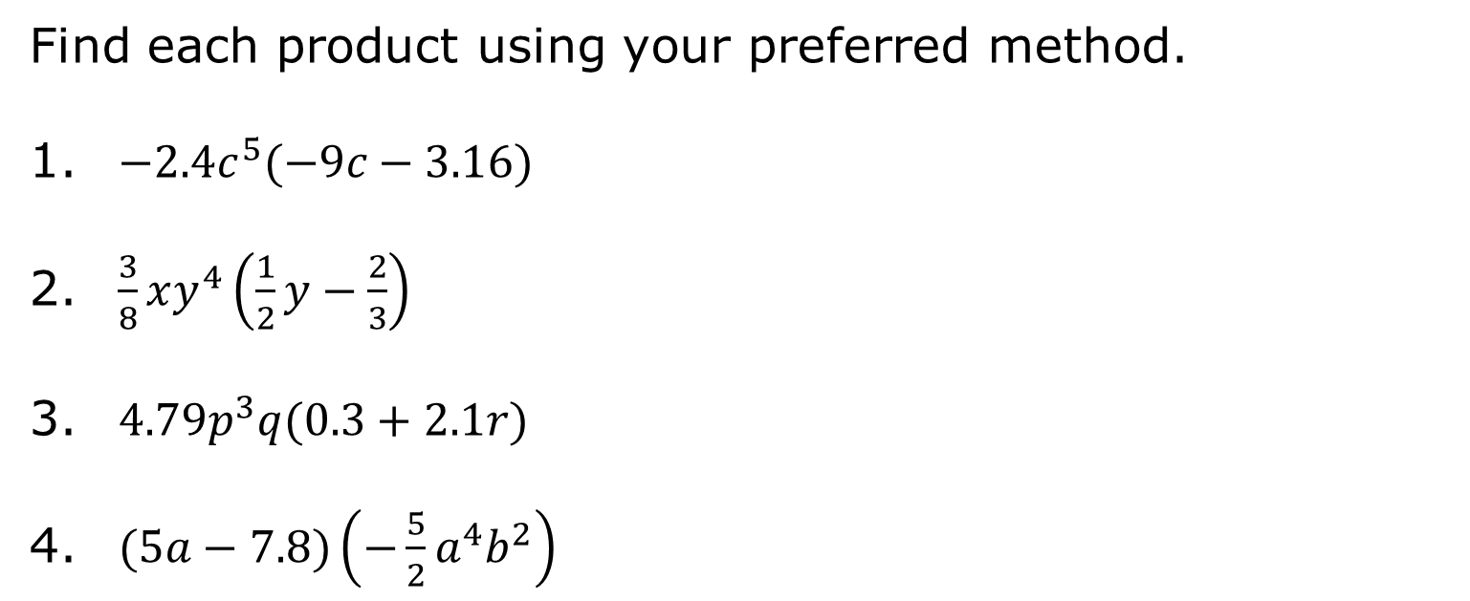
12.2.5 Guided Practice: Multiplying a Monomial by a Linear Expression
Find each product using your preferred method.
${−2.4c}^{5}(−9c−3.16)$
$\frac{3}{8}xy^{4}\left(\frac{1}{2}y−\frac{2}{3}\right)$
$4.79p^{3}q(0.3+2.1r)$
$(5a−7.8)\left(−\frac{5}{2}a^{4}b^{2}\right)$
volume 2, pg. 225

Slide 19

Your Turn
volume 2, pg. 225

Slide 20

12.2.6 Your Turn!
Find each product using your preferred method.
${−4y}^{4}z\left(\frac{3}{2}−8z\right)$
${(12.7f+9.2)(4.01f}^{2}g^{3})$
${\frac{4}{5}m}^{4}n^{2}\left(\frac{7}{2}m−10\right)$
$(2.005−x)∙(x^{5}{yz}^{3})$
volume 2, pg. 225

Slide 21

Wrap-Up
volume 2, pg. 226

Slide 22
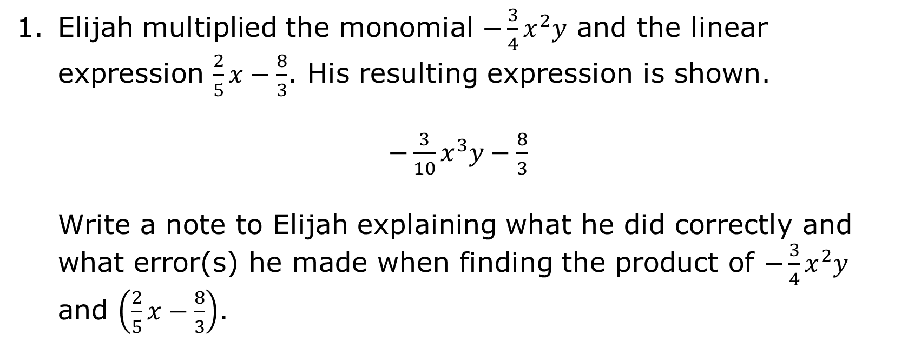
12.2.7 Wrap-Up: Error Analysis
Elijah multiplied the monomial $−\frac{3}{4}x^{2}y$ and the linear expression $\frac{2}{5}x−\frac{8}{3}$. His resulting expression is shown.
$−\frac{3}{10}x^{3}y−\frac{8}{3}$
Write a note to Elijah explaining what he did correctly and what error(s) he made when finding the product of $−\frac{3}{4}x^{2}y$ and $\left(\frac{2}{5}x−\frac{8}{3}\right)$.
volume 2, pg. 226

